Slide 1

Building an
Online Behavior Observatory for Healthcare
Henry Kautz
Professor, University of Virginia
January 2023

Slide 2
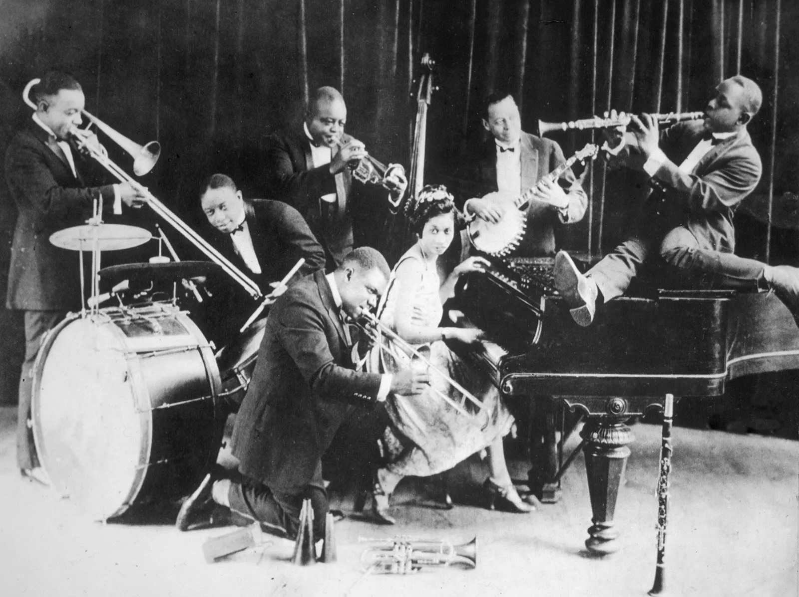
About Me
AT&T Bell Labs (1987-2000): Logical knowledge representation, practical satisfiability testing, randomized search algorithms
University of Washington (2000-2007): Speed-up techniques for search, AI for assistive technology, location-based activity recognition
University of Rochester (2007-2018): AI for assistive technology, social media analytics
National Science Foundation (2018-2022): Director of division that funds AI and HCI
WAYO Radio DJ (2023): Roots of Jazz and Blues with King Henry, archived at https://henrykautz.com
University of Virginia (2024)

Slide 3
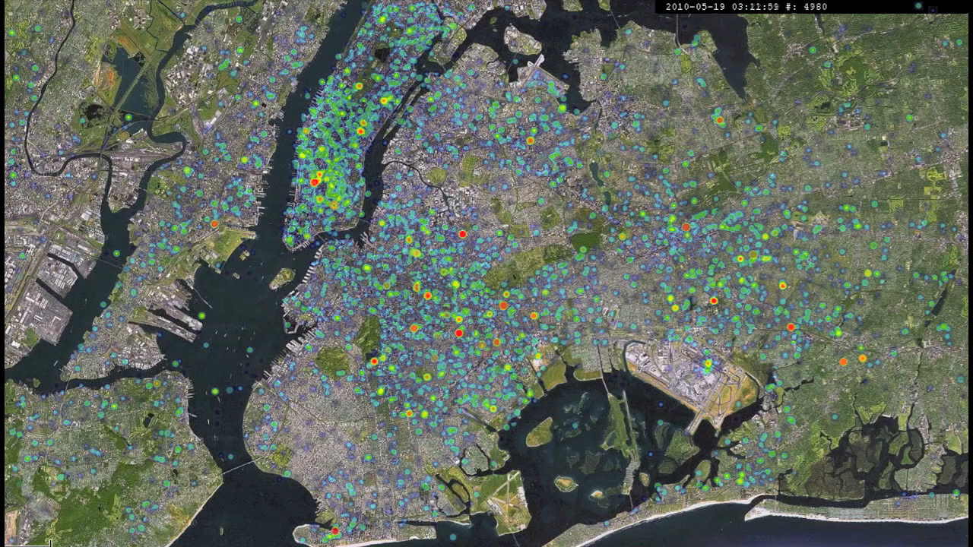
Leveraging Online Behavior For Public Health
Using online behavior “exhaust”
  Search, social media, video, …
  Population scale
  Fine granularity
  Timely
  “Organic sensor network”
To answer public health questions
  Who is likely to contract disease?
  What behavioral factors influence health?
  What are environmental sources of disease?
24 Hour Heat Map of Tweets, NYC

Slide 4
Outline
Twitter Health: Predicting Spread of Contagious Disease
nEmesis: Locating Sources of Food-borne Illness
MEW: Mental Health Evaluation Using Web Data
Building an Online Behavior Observatory for Healthcare

Slide 5
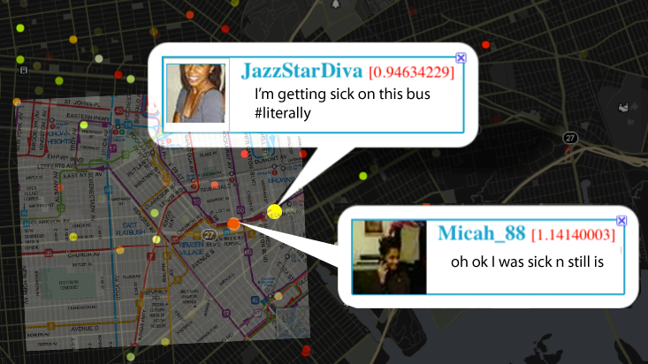
Twitter Health: Predicting Spread of Contagious Disease
2012-2015

Slide 6
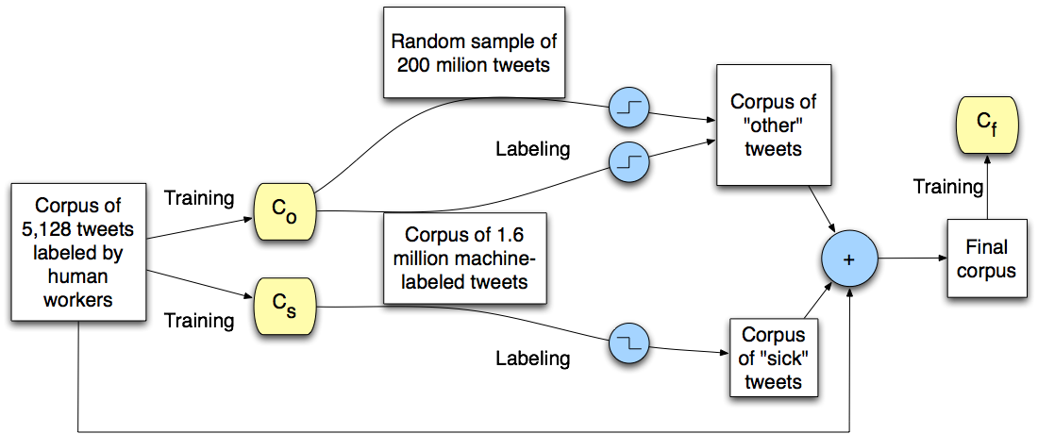
Finding Tweets About Flu Symptoms
Previous work: keywords
  Problems: “sick of homework”, “under the weather”
Our approach:
  Support Vector Machine using word
  trigrams
  Semi-supervised learning using
  Mechanical Turk
  98% accuracy

Slide 8
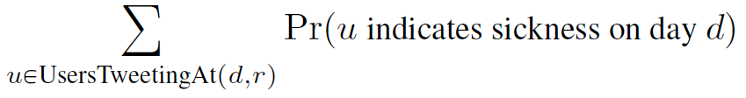
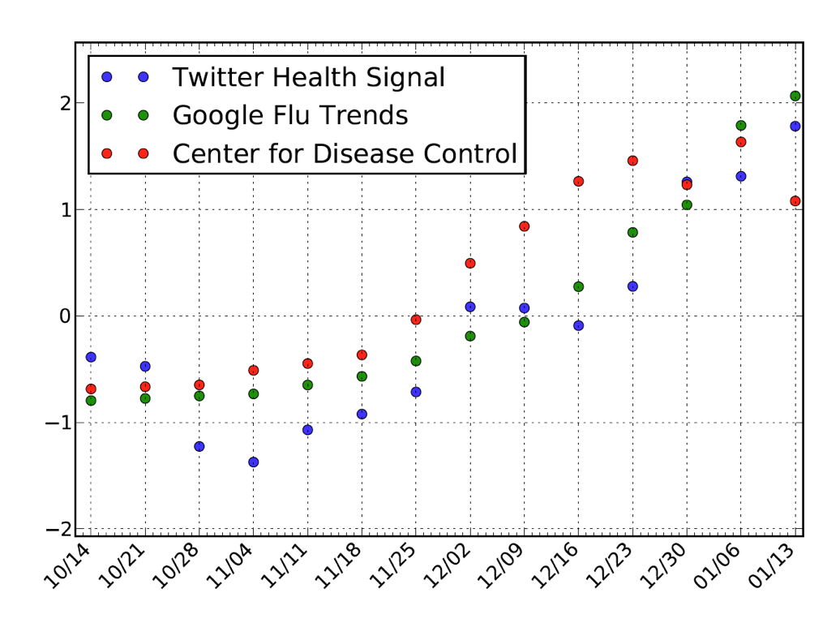
Validating Twitter Health Signal
Change in influenza rate
NYC, Boston, Los Angeles,
Seattle, San Francisco
Correlation with CDC:
R=0.80, p=0.002
Correlation with Google Flu Trends:
R=0.87, p=0.0002

Slide 9
Geolocation Analysis
At time of data collection (2012-2015), most tweets were GPS tagged
Possible to infer an individual’s
  Movement from place to place
  Home location
Enabled prediction of individual developing disease based on
  Encounters with sick-tweeting individuals
  Encounters with sick-tweeting friends (mutual followers)
  Encounters with environmental factors
After 2017, GPS tagged posts became rare

Slide 10
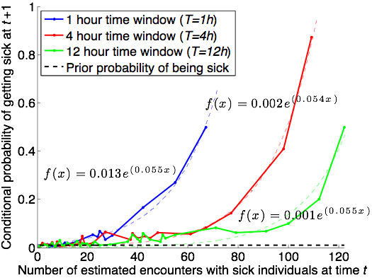
Impact of Co-Location
Impact of encountering 50+ sick users is strong

Slide 11
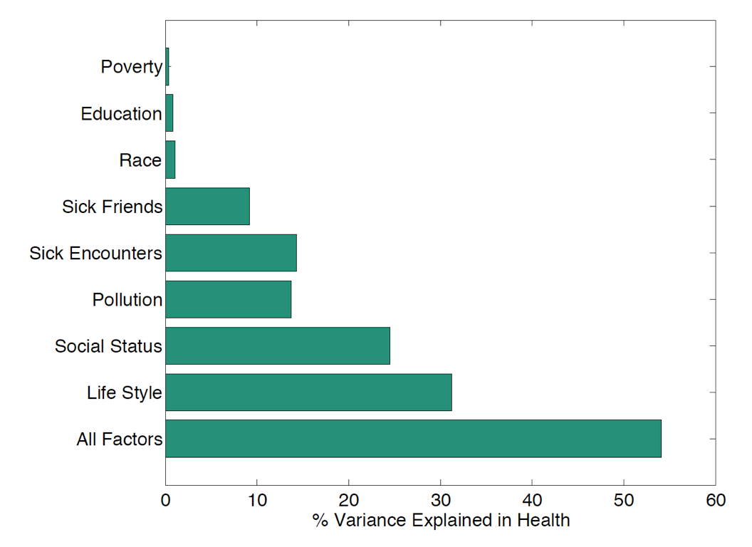
Factors Influencing Health
Regression analysis using factors derived from GPS and social network measures
Fraction of variance in health explained by various subsets of factors
Poverty, Education, and Race are derived from census data for user’s home ZIP code.

Slide 12

nEmesis: Locating Sources of Food-borne Illness
2015-2018

Slide 13
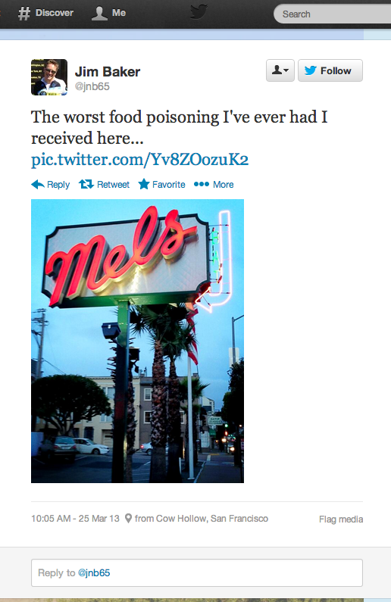
Foodborne Illness
Affects 48 million people annually in US
  128,000 hospitalizations, 3,000 deaths
Primary public health tools
  Licensing requirements
  Inspections of food venues
Challenges
  How can we target inspections more effectively?
  How can we find problematic unlicensed venues?

Slide 14
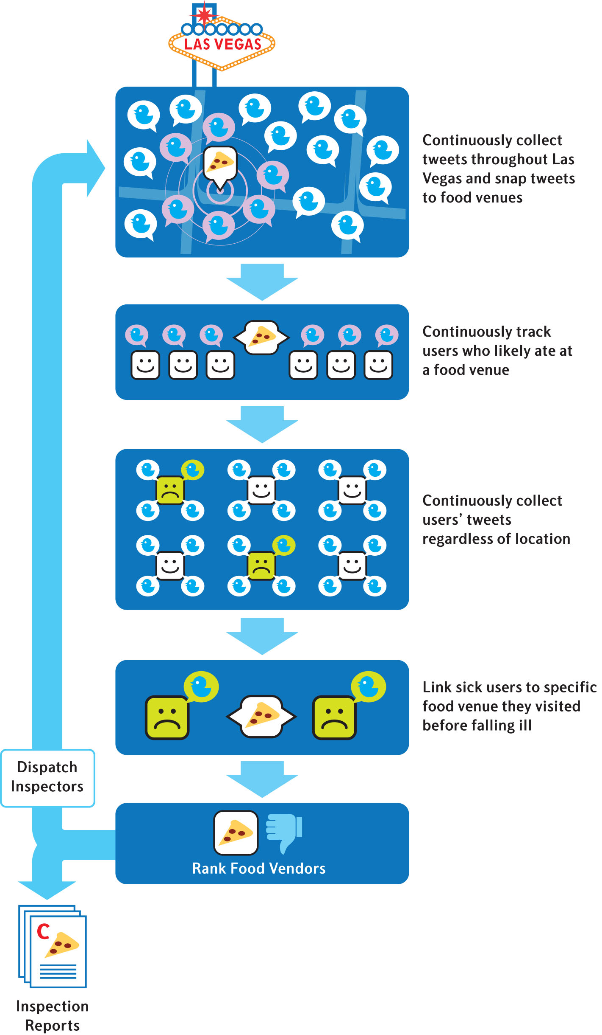

Slide 15
Las Vegas Trial
3-month trial by Southern Nevada Health District (Las Vegas)
Venues with highest predicted risk flagged for inspection
  Paired control venues also inspected
  71 adaptive / 71 control inspections
  Inspectors blind to which are
  adaptive

Slide 16

Results
Adaptive inspections uncover more violations
  9 demerits vs 6 demerits (p = 0.019)
  57% more “C grades” discovered
Adaptive inspections estimated to prevent 71 infections and 4 hospitalizations during trial
nEmesis alerted health department to an unlicensed seafood venue
System replicated with similar results using Google search data instead of Twitter
  Chicago and Las Vegas
  Sadilek et al., npj Digital Med 1, 36 (2018)

Slide 17

MEW: Mental Health Evaluation from Web Data
2019-2021

Slide 18

Prevalence of Mental Illness
25% of adults suffer from mental illness
Large increase in mental illness about among high-school and college-age youth since 2019
Most mental illness is untreated
  60% if youth with major depression receive no treatment
Notes:
In US 1 in 5 individuals experience some form of Mental illness every year
50% of these begins by age 14
National Institute of MH estimates that only 40% people who suffer from mental illness seek help
Clearly mental illness is a major public health concern, that can:
Affect the course of other medical conditions and diseases
Incur great cost from economic standpoint

Slide 19

Traditional Mental Health Care
Patient must proactively seek care
Mental illness symptoms may be triggered by life events that recede by the time patient meets provider
Reliance on patient self-report makes diagnosis difficult when patient unintentionally or deliberately conceals information
Can we create a scalable way to continuously screen a population for potential mental health concerns?

Slide 20




Why Not Rely on Public Social Media Data?
Many researchers have attempted to derive a mental health signal from users’ social media posts
Limitations
  People frequently self-censor and deliberately create false self-images
  Studies rarely have access to ground truth of subjects’ mental health
  Often require to proprietary data
  Have provided no general, scalable, and privacy-preserving data tools
Notes:
Social media data has been the most popular form of information that has been studied in the research community to model and understand various aspects of MH conditions
However, social media data has its challenges: self selection bias, sensoring contents, posting things that are socially acceptable, fear of stigma
data is only gathered from users of particular social media sites.
Because users self-select for particular sites, there may well be confounding factors that influence both the users’ mental health and their online behavior.

Slide 21
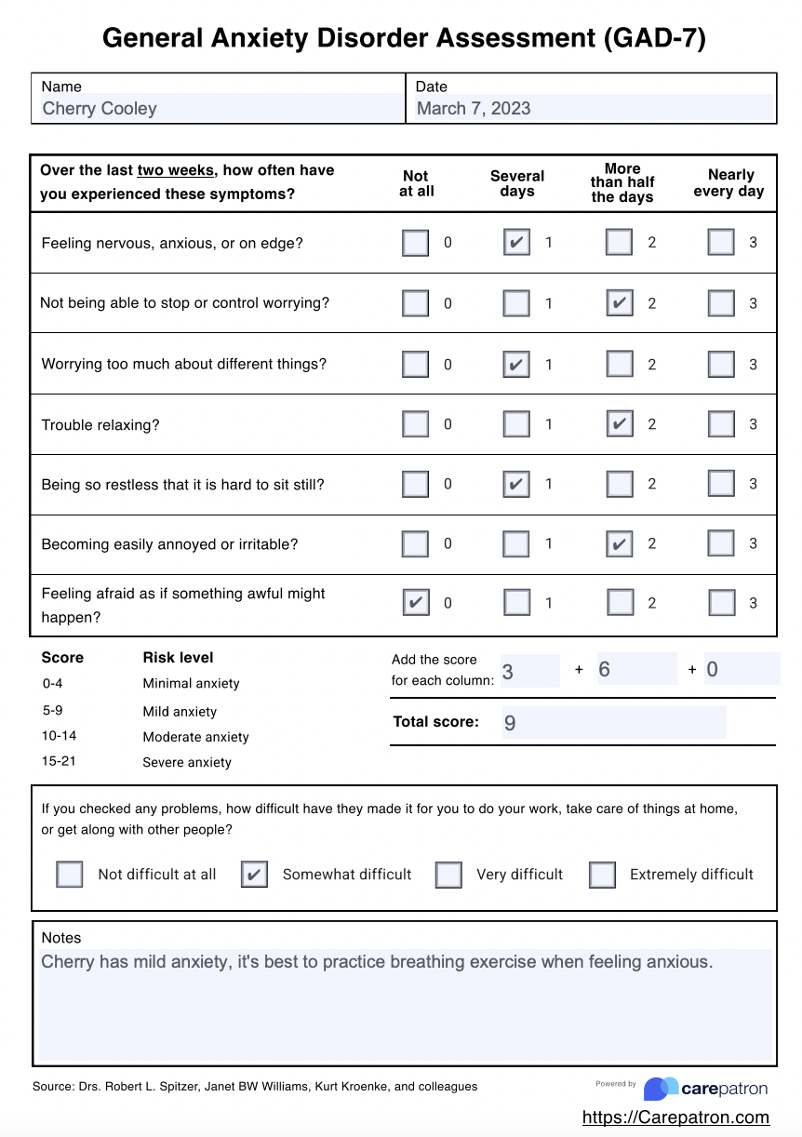
Data Sources
Ground truth
  Age, gender, academic, demographic
  Depression: Patient Health Questionnaire (PHQ-9)
  Anxiety: Generalized Anxiety Disorder (GAD-7)
  Rosenberg Self-Esteem Scale
Online behavior: Google Takeout
  Google search history
  YouTube viewing history
  Chrome browser history
  GPS history
  Google Photos …
Notes:
2nd component of our data: the ground truth mental health information
we collect via the survey University’s Red Cap system allows us to easily design questions and collect data
We gather:
Age, gender, demographics info
For Mental health we use clinically validated psychological instruments as surveys
PHQ (0-27)
ROS(0-30)
GAD7(0-21)

Slide 22
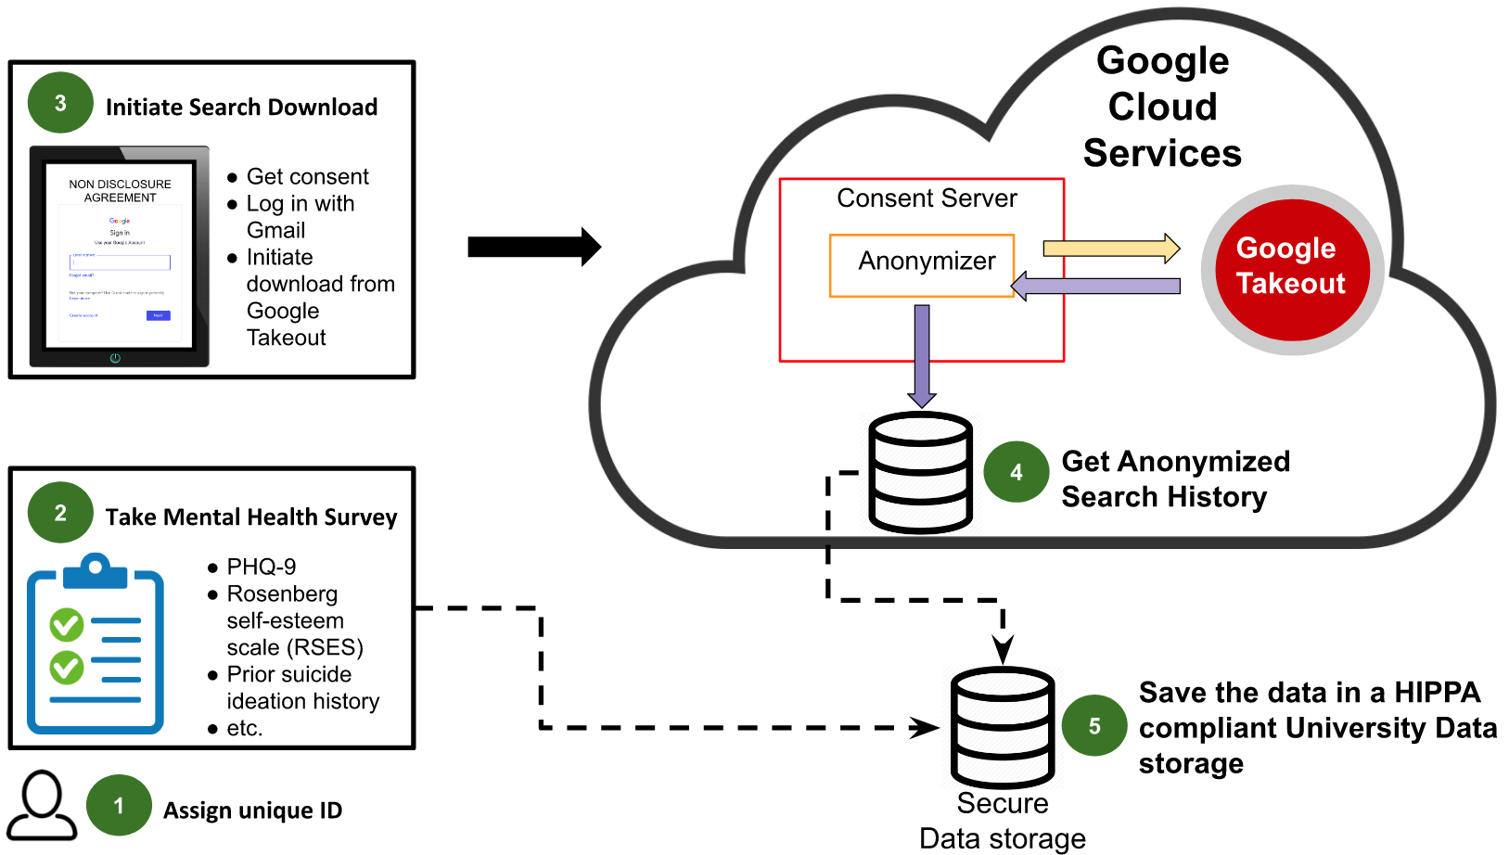
Mew Platform
Notes:
A big picture overview of the whole data collection process for a particular individual

Slide 23
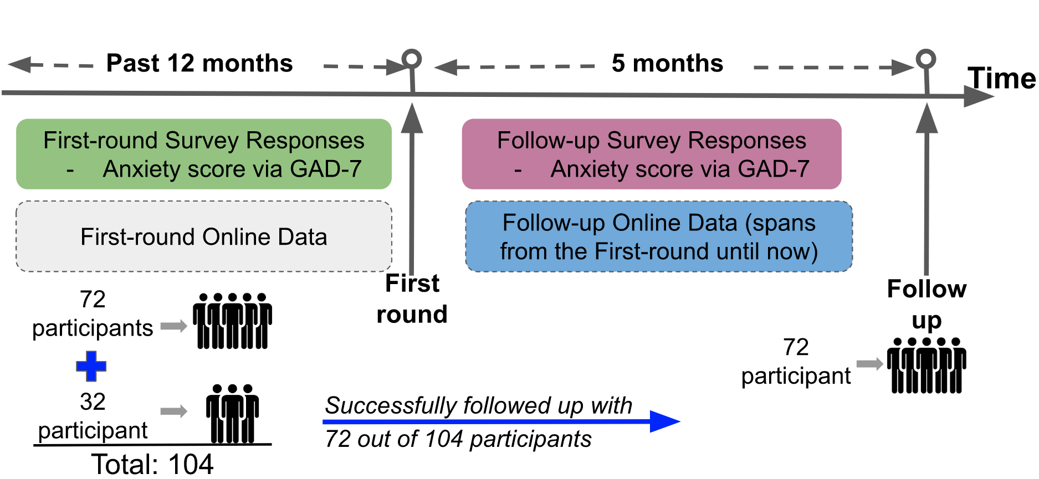
Anxiety Detection & Prediction Longitudinal Study
Given online data at time T, detect anxiety (GADS-7>9) at time T
Given GADS-7 score at time T1 and online data at times T1 and T2, predict GADS-7 score at time T2
Notes:
Anxiety disorder is one of the world’s most prevalent mental health conditions (WHO reported)
Current methods: in-person interviews, which is expensive, time-consuming, and blocked by social stigma
In this work, we can identify an individual suffering from potential anxiety disorder and even more, we can predict their level of anxiety score based on YouTube and Google Search log histories
IMPORTANT: GAD-7 survey questions were used to get ground truth anxiety assessment of the participants

Slide 24
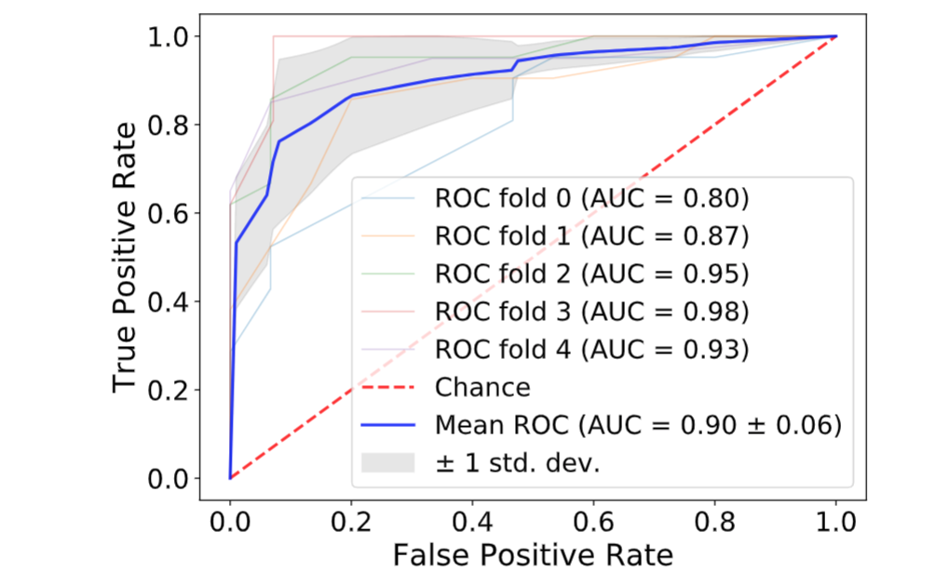
Task 1: Online_{T}→Score_{T}
Given online data at time T, detect anxiety (GADS-7>9) at time T
Random Forest
5-fold cross validation
Notes:
Since RF performed the best, we plotted the ROC for the RF
The area under the curve, called AUC, tells us how well the model is performing
AUC goes from 0 to 1. 1 → mode is perfect

Slide 25
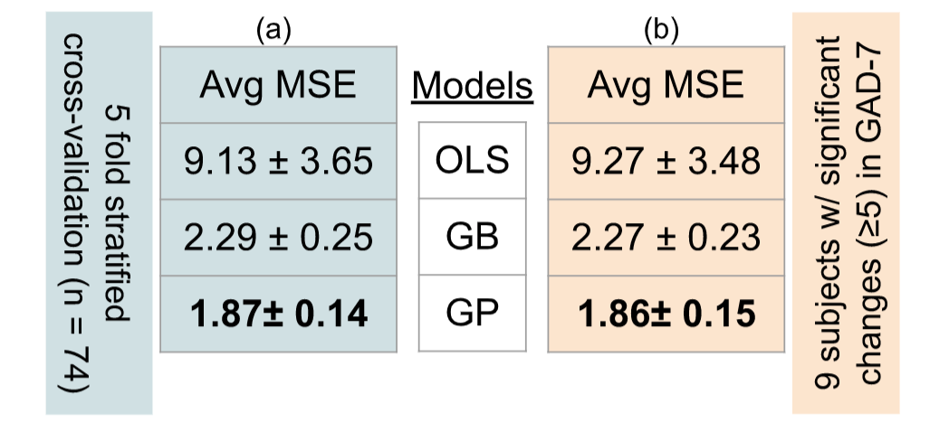
Task 2: Score_{T1}, Online_{T1}, Online_{T2} → Score_{T2}
Least
Squares
Regression
Gradient
Boosting
Gaussian
Process
Regression
Notes:
Since regression, we use avg MSE as the metric to assess how well the models are performing.
Lower the MSE, the better.
Carried out 5 fold cross val (used only the participants who participated both during the first and follow up round, n = 74)
GP out performs both OLS and GB
NOW:
There were 9 individuals whose anx score changed significantly(>=5) between the two rounds
We want to see how well the models do on them
As we did the 5 fold cross val, we ensured that those 9 folks are always in the test test
Column (b) shows the avg MSE metrics for the models when we followed this process
Basically, shows that GP is quite flexible in capturing significant changes in GAD-7 scores (b)

Slide 26
Building an Online Behavior Observatory for Healthcare
Now in Progress

Slide 27
Motivation
Previous studies relied on one-off systems to gather data
  Require CS expertise to modify
  Takes months for Human Subject Review Board approval
  Limited to one or two data sources
  Not open source
  Only useable for research, not clinical practice
Goal: Online Behavior Observatory
  Modular and open source
  Customizable by non-CS experts
  HIPAA compliant
  Include Therapist and Patient Dashboards
  Support truly informed consent

Slide 28






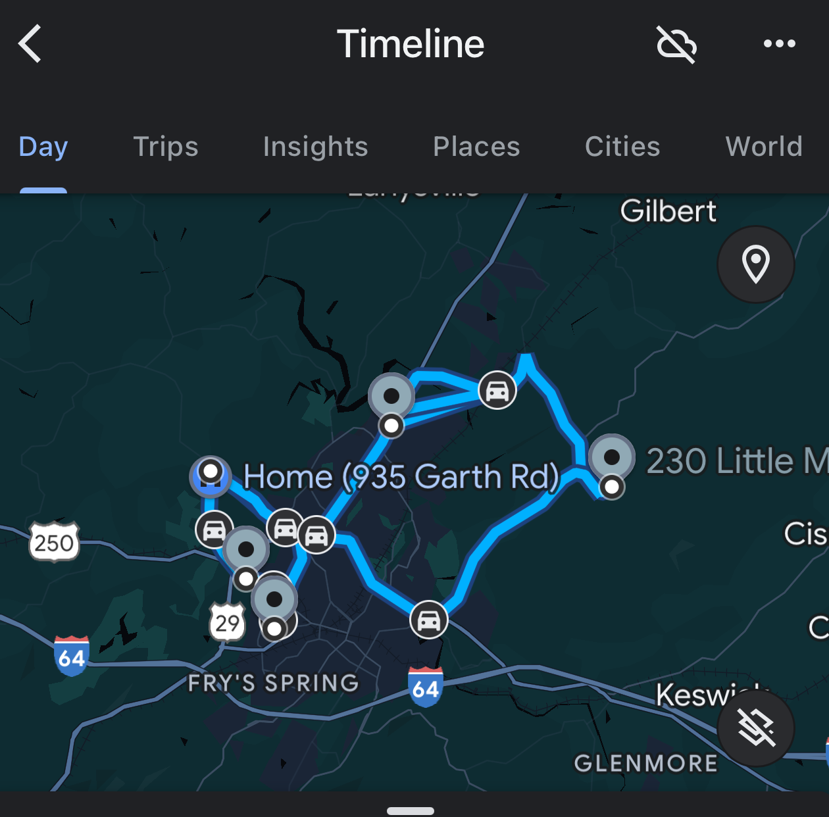



Collector
Collector
HIPPA
Database
Collector
Collector
Analytics
Collector
Collector

Slide 29
Modules
Consenting
Data collection
  Web Search
  Social media – X, Facebook, TikTok, …
  Entertainment – YouTube, Twitch, Netflix, …
  Location, travel, places
  Pop-up surveys (ecological momentary assessment)
Data cleaning and store
Analytics
Dashboards
  Configuration
  Researchers
  Clinician
  Subject

Slide 30
Therapist Dashboard
Notes:
Imagine an application that taps into your online activities and constantly assess your depression, anxiety, and self-esteem level
Your therapist/counselor has access to these plots
These plots are generated live!

Slide 31
The Problem of Informed Consent

Slide 32


Patient Dashboard
Release to therapist?
Yes
No
You have been on your phone all day. How about going for a walk?
Notes:
Imagine an application that taps into your online activities and constantly assess your depression, anxiety, and self-esteem level
Your therapist/counselor has access to these plots
These plots are generated live!

Slide 33
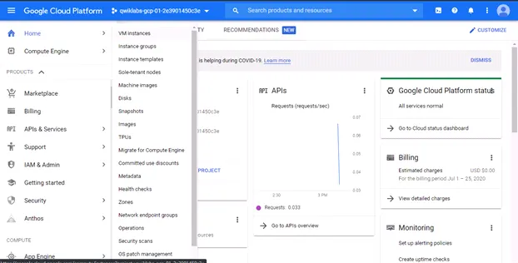

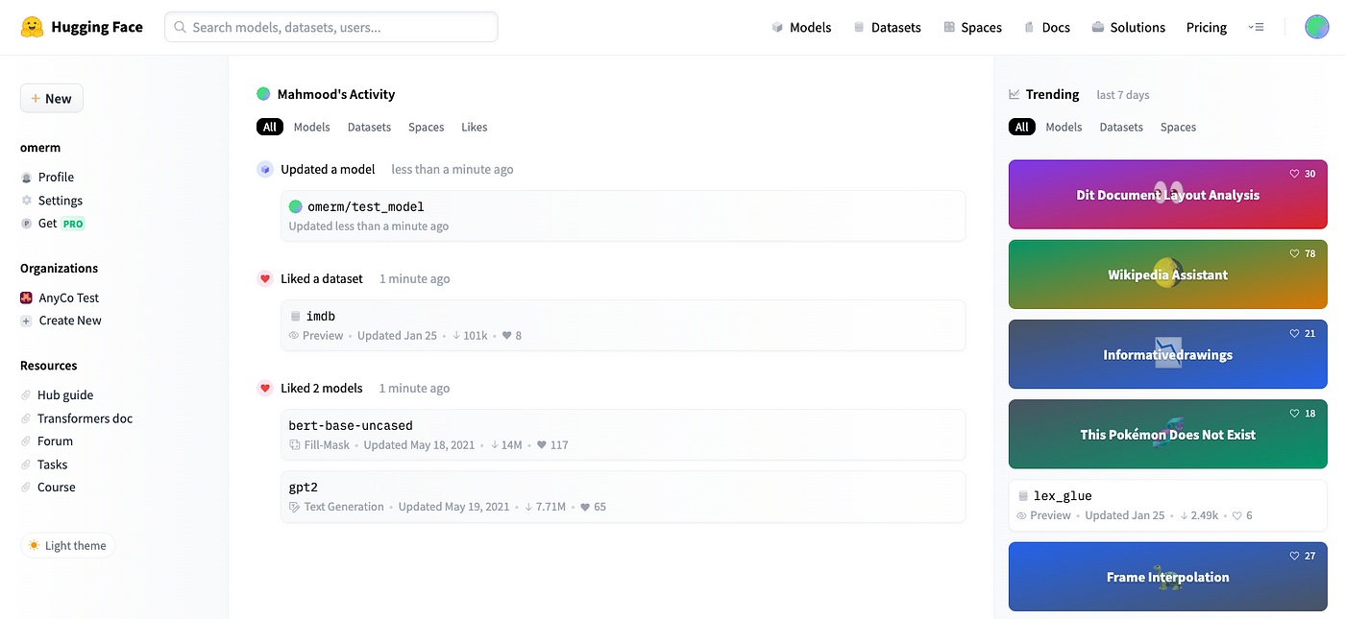
Researcher Dashboard
Select Subjects
Select Date Range
Download
Link to Google Cloud Engine
Link to Hugging Face

Slide 34
RA Qualifications
Human-Computer Interaction: needs assessment, user studies, user centered designed
Front end programming: react, angular, typescript
Cloud computing: Google Cloud, AWS
Machine learning: scikit-learn, pandas, matplotlib
Interest in healthcare applications
Excellent communication skills: running focus groups, working with doctors, subjects, psychology faculty and graduate students

Slide 35
Emerging Project:
LLM with Tools → Machine Consciousness
Masters Project Available Now

Slide 36


One Approach to Neural-Symbolic Integration
Imbed true symbolic reasoning inside a neural engine
Enable super-human and super-neuro combinatorial reasoning
  For deliberative, Type 2 reasoning
  Rare in ordinary animal life
  Common in “business AI”

Slide 37

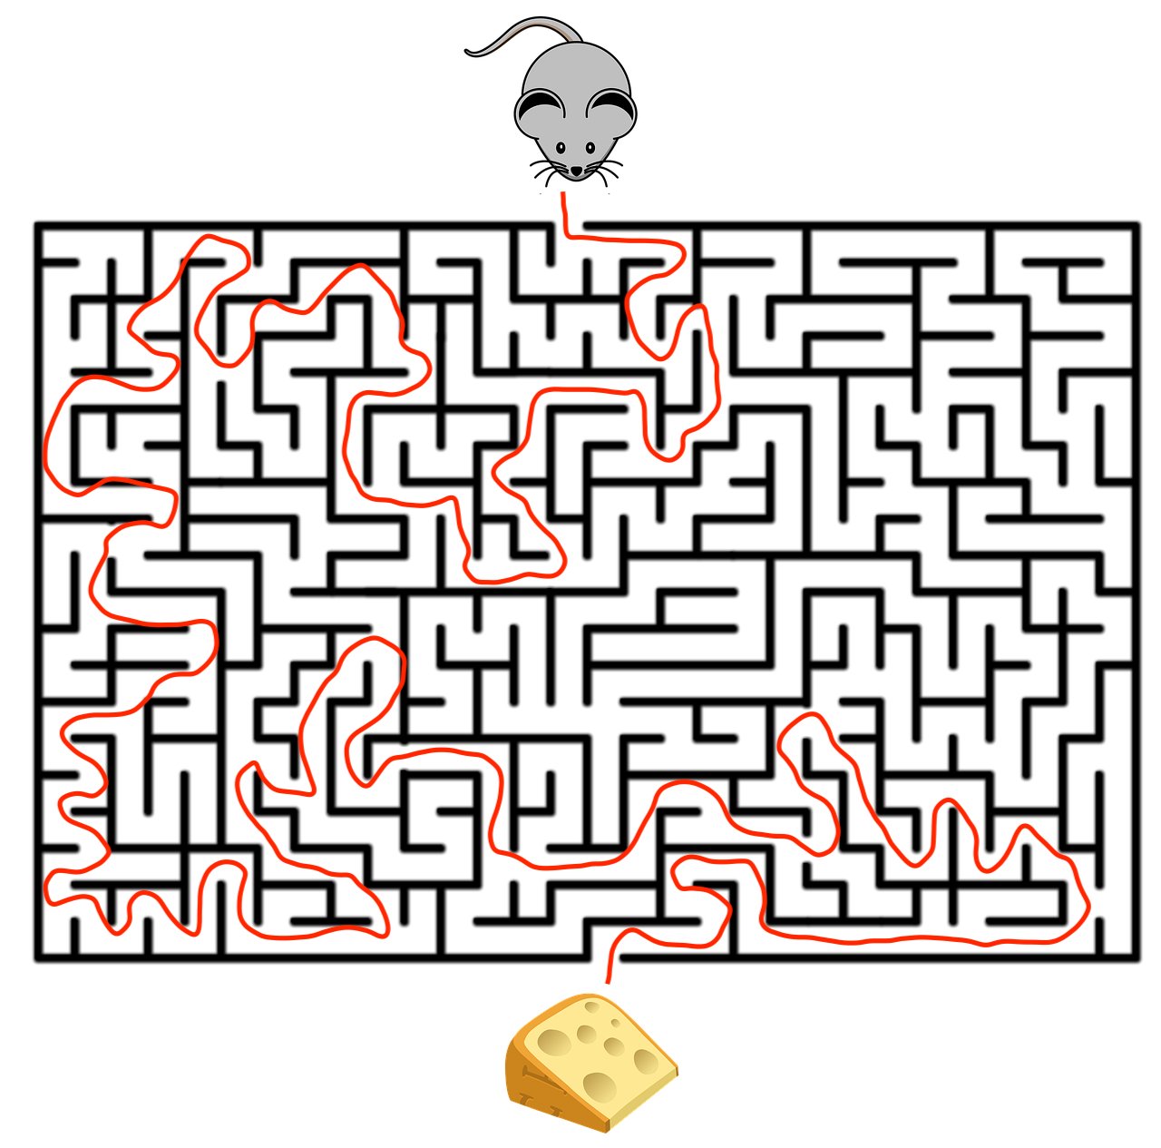
Symbolic Reasoning Engine
Go_To(Cheese)
Decoder
Encoder
Neural Network
Forward(1)
Turn left
Forward (3)
…

Slide 38
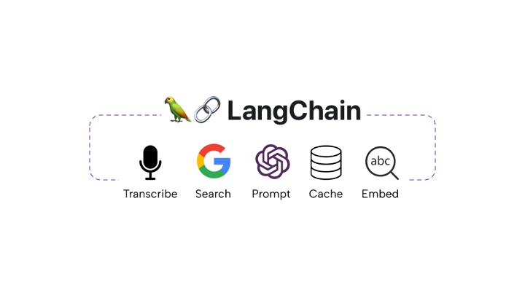
LLM With Tools
Instance of “LLM with tools”
  LangChain
LLMs commonly use tools for
  Real-time web search
  Citation-checking
  Calculations
  Database access
Tools can also cure LLMs’ weaknesses in symbolic reasoning

Slide 39
Example: Zebra Puzzle

Slide 40
GPT-4o Off To A Good Start

Slide 42
Prompt

Slide 43
GPT Translates Without Additional Instruction

Slide 45
General Approach
Prompt GPT to recognize situations that require logical reasoning
  Specify tool(s) to try – SAT engines, Prolog, theorem prover
  State whether to formalize as a constraint satisfaction (SAT) or deduction (UNSAT) problem
Same approach can be used for planning and probabilistic reasoning
  SatPlan, FF
  Bayes Net solvers
Key open problem: pulling in relevant background information when necessary
  Instantiate knowledge encoded in LLM
  Augment with knowledge from other sources, e.g. RAG

Slide 46
Thought Experiment
Intelligence is a combination of fast pattern recognition (Type I), slower step-by-step thinking (Type II), and consciousness.
LLMs can perform Type I thinking.
LLMs can use formal reasoning tools to perform Type II thinking.
LLMs can reflect upon their thoughts and actions, which indicates they may be conscious.
We can therefore hypothesize that LLMs are intelligent.
Neuro-science like research on LLMs (e.g. ablation, stimulation, …) will reveal universal truths about the nature of intelligence

